Slide 1
CUSTOMER PREDICTION
BA TECHNOLOGY, DATA, & INSIGHT

Slide 2
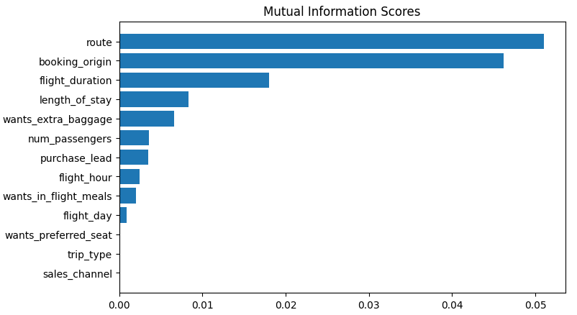
RESULTS
Evaluation:
The most critical feature in the model was route, that is the route from source to the destination.
The features that affected the flight booking the most were: route, origin of booking, duration of the flight, want extra baggage, length of stay.
The accuracy of the model was approximately 0.85 (accuracy) and 0.55 (AUC), implying that this model needs more improvement.

